Slide 1

Lessons from
new ways of working
outside of IT
Ellie Taylor
Nationwide Building Society
^{?th} June 2020

Slide 2
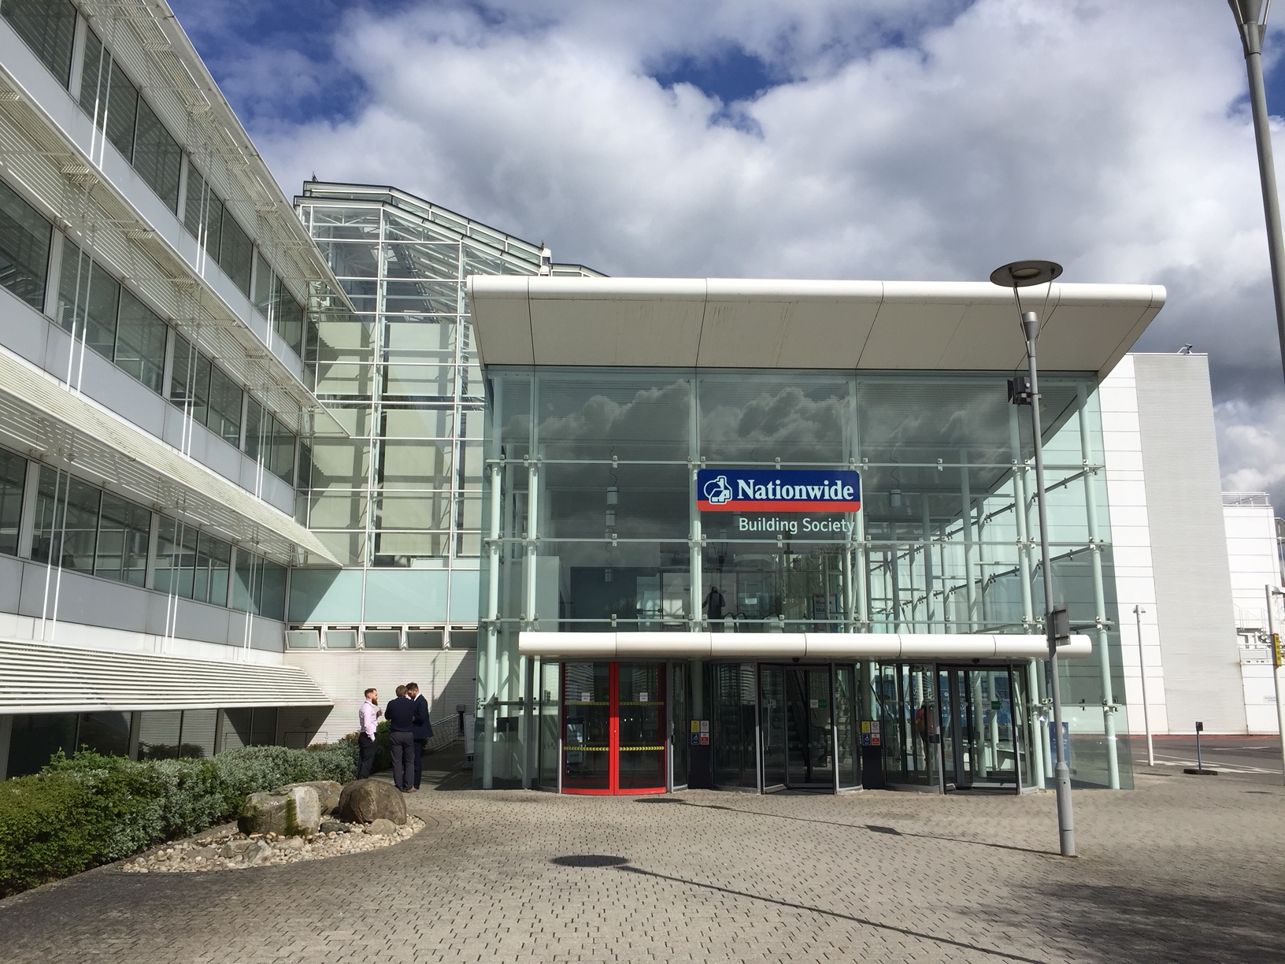
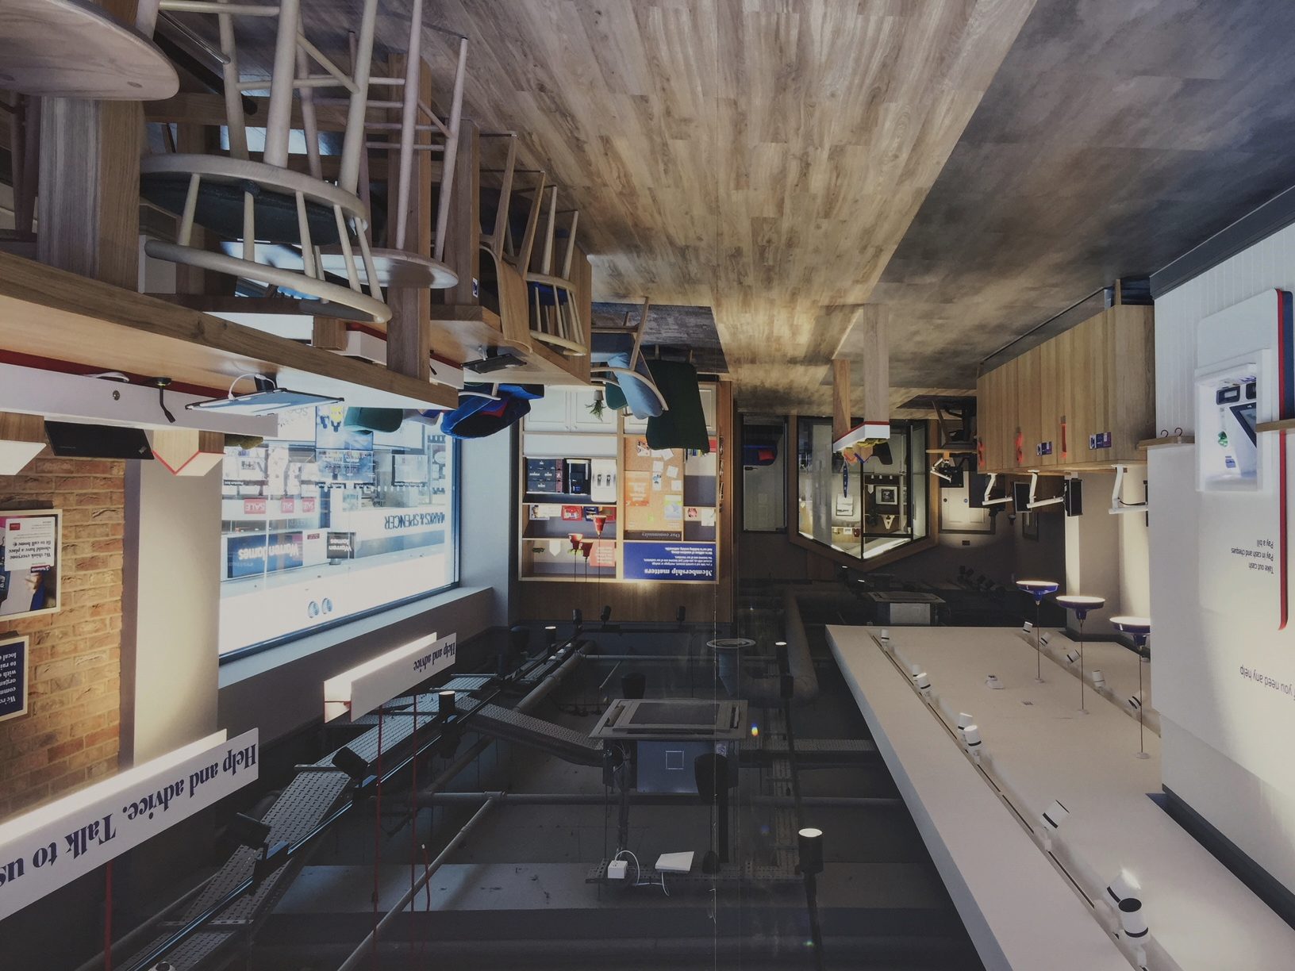
OUR CONTEXT – fertile ground!
80 auditors, broadly aligned to business portfolios
Majority located with business in Swindon, sub offices in other locations
Small teams, average lead time 12-16 weeks per audit
Traditional hierarchy, standard linear methodology
Motivated individuals willing to embrace change and innovation – not to be underestimated!
Taken 2 years months, but all audits are using new ways of working in some form

Slide 3
HOW DID WE DO IT?

Slide 4
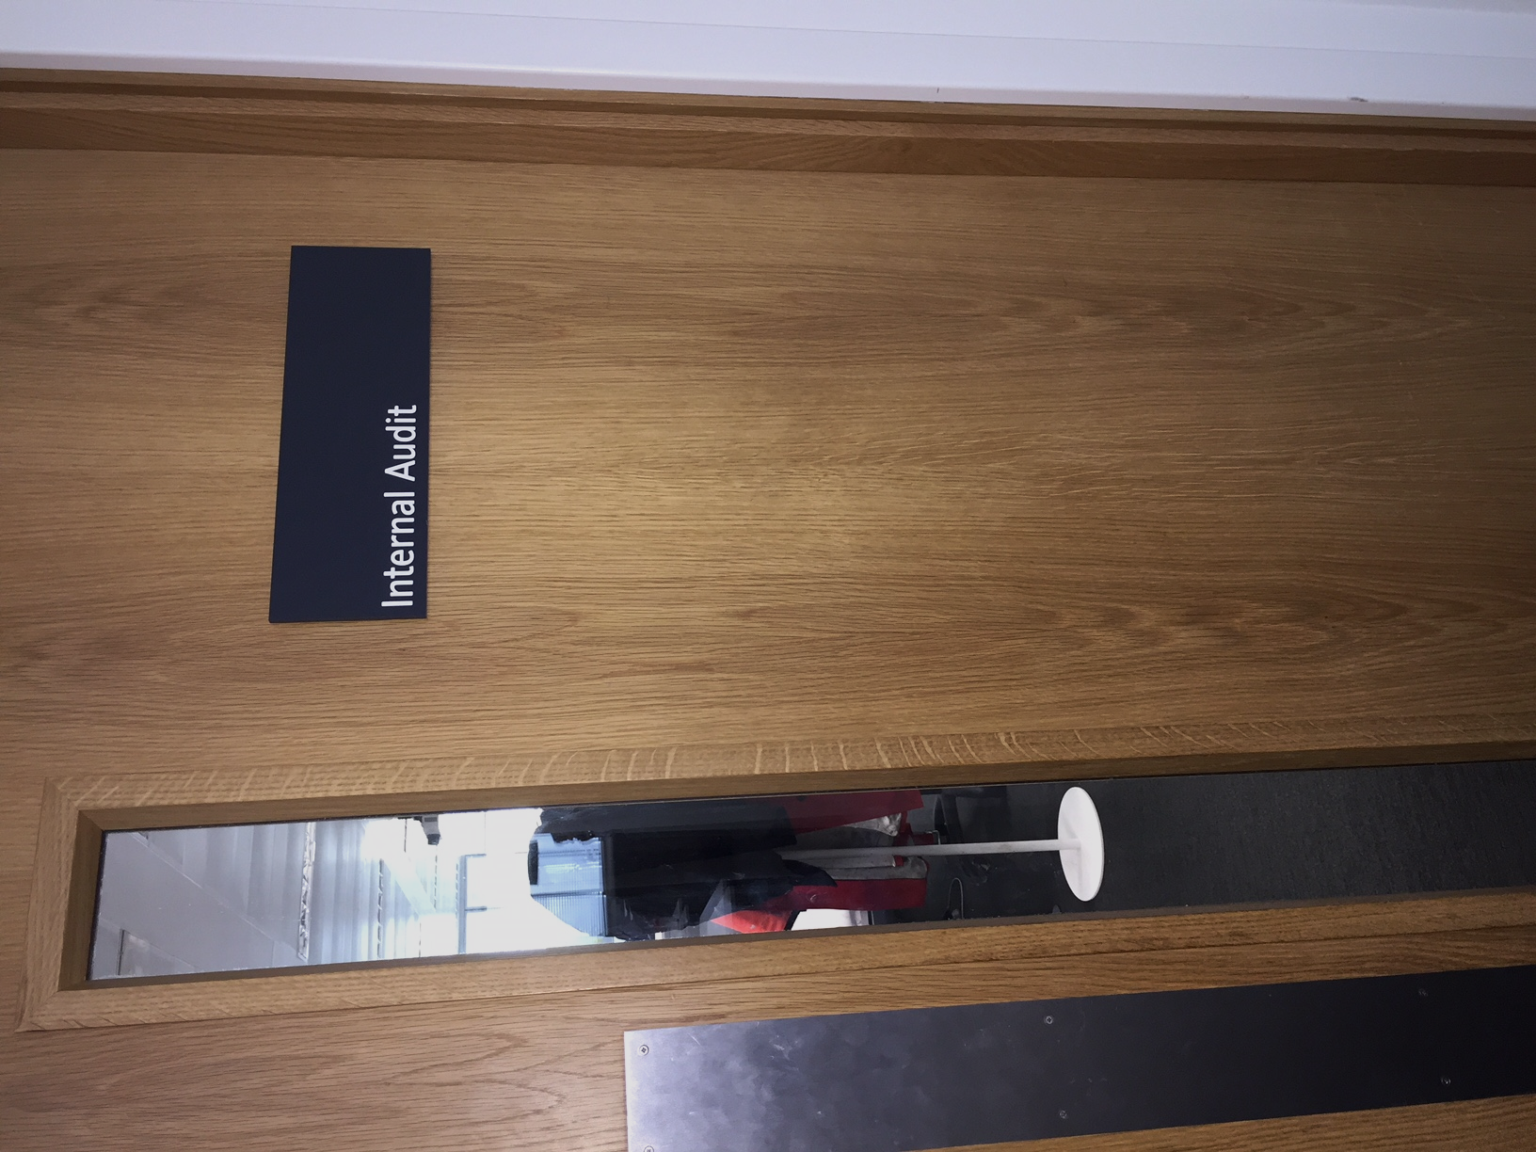
THE WHY: REASONS FOR CHANGE
Grow Internal Audit’s relevance as a function
Re-invigorate the IA profession; the value we bring, how we work and how people view us
Forward looking, responsive and adaptive in a fast-paced and ever-changing world
Continuously provide Audits of the highest value
From perception of secretive and behind a closed door, to a welcome and trusted advisor
Improve flow and quality

Slide 5
Feedback from our Auditees
Internal Audit have demonstrated courage and innovation … great collaboration and highly effective interaction between Internal Audit and the wider organisation … speed and effectiveness have improved as a result.
Joe Garner, Chief Executive Officer
…enabled the right conversation to be held at the right time. I am a great fan.
Head of Commercial and Treasury Credit Risk
Effective and efficient. Aided collaboration, so that information and responses could be shared more quickly. Facilitated openness between audit team and auditee, and the transparency meant there were no surprises.
Director of Finance, on behalf of the Pension Risk Team
A very positive experience. Engaging, lifted the lid on what Internal Audit do and ensured I was able to provide useful and timely input.
Director of Engagement and Leadership
The approach to audit was new, which I found to be effective in working through issues during fieldwork and drafting the final report.
Director of Financial Prudential Risk Oversight

Slide 6
CONTEXT IS THE THING

Slide 7
VALUES IMPORTANT TO US
Continuous Collaboration
Continuous Prioritisation
Delivering Valued
Audits
Longer
Lived Teams

Slide 8
THE WHAT: OUR VISION
Delivering Valued Audits
EFFICIENT DELIVERY
VALUED AUDITS
ENGAGED TEAMS
Quicker, providing increased capacity
More productive, less waste and delay
Greater predictability
Adaptive to change and discovery
Always of the highest value and impact
Achieved through collaboration
Earlier insights and observations
Transparency of process
Engaged team members
In the flow
Motivated
Sustainable pace
Metric:
Lead Time
Metric:
Post Audit Feedback
Metric:
Net Promoter Score

Slide 9
BENEFITS – THE METRICS
EFFICIENT DELIVERY: LEAD TIME REDUCED FROM 16 WEEKS TO 12 WEEKS
VALUED AUDITS: 100% OF AUDITEES CONSIDER AUDITS VALUABLE
ENGAGED TEAMS: NPS = 12
ADDED BONUS
BETTER UNDERSTANDING TO SUPPORT AND CHALLENGE IT & CHANGE TEAMS

Slide 10

POWER OF THE TEAM
Our unit of change is an AUDIT
Method of delivery is through a TEAM
THE CHALLENGE
WHAT we do cannot change
But HOW we do it can
THE OPPORTUNITY
Knowledge workers, so….
Pivot to teams with autonomy, mastery and purpose (Dan Pink, Drive)

Slide 11
LEADERSHIP IS KEY TO EFFECTIVE TEAM WORKING
Main priorities of leaders:
Design the Teams - focus on them being longer lived
Prioritisation - pipeline of work for the Teams
Limit work in progress - allow focus
Set the intent - agree the scope and empower the teams, stop commanding
This is hard – behavioural change
Sufficient time and energy needed

Slide 12
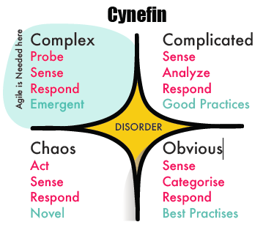
THE HOW: CHANGING OUR WAYS OF WORKING?
OUR CONTEXT
Mostly complex work, some complicated
Unknowns impact the work we do
AND, we deliver using teams…
SCRUM AN OBVIOUS CHOICE
Framework to build high performing teams (incl. team of 1)
Enforced inspect and adapt loop
Visualise workflow
Continuous collaboration & communication

Slide 13

WHAT’S HELPFUL?
3 ROLES
4 EVENTS: Not all viewed as useful at the beginning
SIZING: Breaking down tasks to half a day/day, no bigger
PLANNING: Happy path, very tricky with auditors
VISUALISATION: Physical whiteboard as default, electronic as last resort
CO-LOCATE WITH BUSINESS: They love it!
AGILE COACH: with knowledge of agile outside of IT
CONTEXT: USING SCRUM IN AUDIT

Slide 14

AND WHAT’S NOT HELPFUL?
JARGON: ceremonies, user stories, t-shirt sizing, planning poker…
FULL-TIME SCRUM MASTER: teams cannot sustain it
CROSS-FUNCTIONAL TEAM: within audit yes, but across business no
INTERNAL AND EXTERNAL EVENTS: don’t invite business to all events
ESTIMATION OF TIME: – “There or there about”
CONTEXT: USING SCRUM IN AUDIT

Slide 15
WHAT’S THE MOST IMPORTANT THING WE’VE LEARNED?
FOLLOW THE RULES
BREAK THE RULES
TRANSCEND (MAKE) THE RULES
REMEMBER:
Context is the thing
It will stick if you adapt for your context
If something doesn’t work ditch it.

Slide 16
LATEST IMPROVEMENTS - Rolling Wave Planning
Annual Plan
Takes many months to create and baseline
Is out of date the day it’s published
Cottage industry to manage and apply change control
Rolling Wave Plan
Quick to create and based on placeholders. Make it visible and easy to update
Continuous prioritisation, with greater certainty towards current Quarter
Annual view good enough to ensure skills match and recruitment strategy
Formally reviewed each quarter
Save a huge amount of effort and embrace a little uncertainty & adaptive capacity!
AGAIN, IT’S THE MINDSET SHIFT THAT’S THE HARDEST PART

Slide 17
Your thoughts,
feedback or questions?
Please stay in touch: eleanor.taylor@nationwide.co.uk

